Slide 1
Improving Transparency and Intelligibility of Multi-Objective Planning
Roykrong Sukkerd
Reid Simmons and David Garlan
September 10, 2020

Slide 2
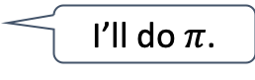
Explainable Multi-Objective Planning
Problem
Approaches
Long-term consequences of actions…
Why this plan?
Explainable Planning:
Tradeoff-focused contrastive explanation
Interactive explanation
Interactions among objectives…
I’ll do $π$.
Unintuitive solution…
Challenging for users to understand agent’s rationale for its behavior
May undermine user’s trust, ability to collaborate with or correct agent
Aims
Better understanding; higher confidence in assessing agent’s decisions
General framework
Notes:
In many planning applications, multiple optimization objectives are common.
Planning often involves complex tradeoff among competing objectives to settle on a best solution wrt certain preference.
In the context of human trust in autonomy, it is important for humans to understand the rationale behind the agent’s decisions, so that they can assess whether the agent is doing the right thing.
However, understanding multi-objective planning can be challenging for humans, due to [C]:
Long-term consequences of actions, and
Complex interactions among different objectives
The planning solution that the agent produces may be unintuitive to humans [C]
[C] In this work, we propose an explainable multi-objective planning approach, for Markov decision process. Our work has 2 parts:
First is tradeoff-focused contrastive explanation approach, where we explain why a solution is selected, in the context of other rational alternatives to convey the tradeoff rationale
Second is interactive explanation approach, where we allow the user to ask questions about the agent chooses specific behavior
[C] The aims of our work are to:
improve the users’ understanding and confidence in assessing the agent’s decisions
Provide a general framework for explainable multi-objective planning

Slide 3
Tradeoff-Focused Contrastive Explanation
Consequence-oriented contrastive explanations for multi-objective Markov Decision Process (MDP) planning

Slide 4
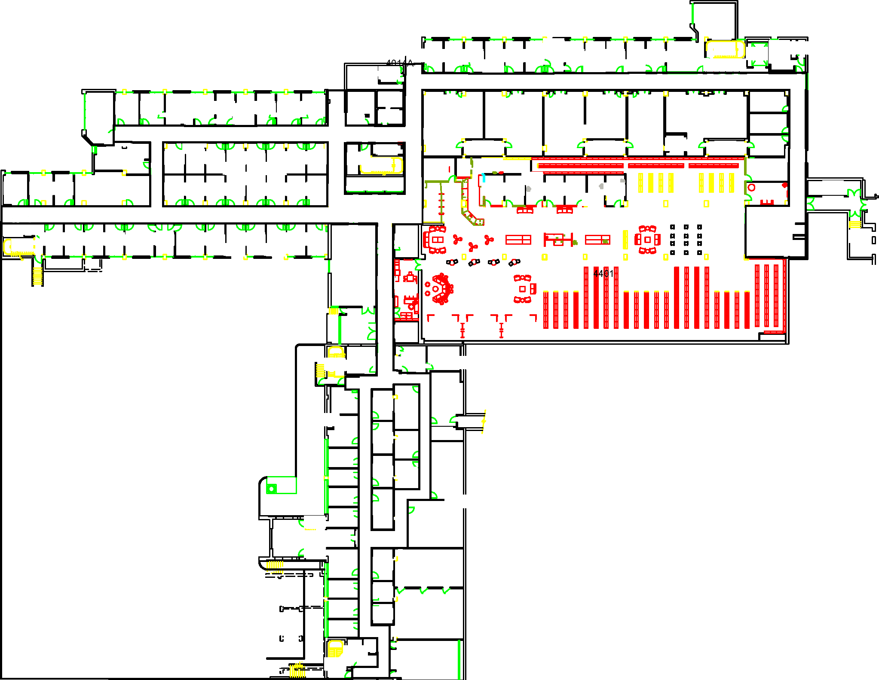
Motivating Example
Sparse Obstacles
Minimize:
Travel time
E[Collisions]
Intrusiveness
Quality Attributes (QAs)
Start
Semi-
Private
I’m planning to follow path.
It is expected to take 5 minutes, have 0.2 expected collision, and be somewhat intrusive.
I could reduce the travel time to 4 minutes by following path instead. However, this
would increase the expected collision to 0.4 and be very intrusive. I decided not to do that because the reduced time is not worth the increased expected collision and intrusiveness.
Private Offices
Goal
Rooms
Dense Obstacles
is a more direct path, but
is less intrusive and has lower chance of collision
Notes:
Consider the following robot navigation example.
The robot is tasked to go to the destination while minimizing travel time, [C] expected collisions with obstacles, and [C] intrusiveness to the building occupants, which depends on the type of areas the robot goes through.
We refer to these concerns as quality attributes. [C]
In this problem setting, different paths to the goal have different impact on the QAs. Once the robot plans a navigation, we want the robot to explain why it chooses that plan.
For instance, suppose the robot chooses the light-blue path. [C] An explanation of this choice is that, while there exists the dark-blue path that is more direct [C], the light-blue path is less intrusive and has lower chance of collision. [C]
Our approach [C] generates verbal contrastive explanations of this form to convey the tradeoff rationale and preference of the robot.

Slide 5
Explainable Planning Approach: Overview
Sparse Obstacles
formulate as
Semi-
MDP Problem Representation
Private
Start
Rooms
Private Offices
Goal
Dense Obstacles
input
Robot’s Task
I’m planning to [follow this plan]. It is expected to [have these QA values].
I could [improve these QAs by these amounts], by [carrying out this alternative plan] instead. However, this
would [worsen these other QAs by these amounts]. I decided not to do that because [the improvement in these QAs] is not worth [the deterioration in these other QAs].
?
Planner
output
Explanation
Navigation Plan
Notes:
The high-level process of our approach is the following:
In a typical planning, we formulate the robot’s task as an MDP problem, and solve for a solution policy.
The goal of our work is to produce an explanation [C] of this solution policy, as shown earlier.
To achieve this, our approach consists of 2 main parts:

Slide 6
Explainable Planning Approach: Overview
Sparse Obstacles
formulate as
translate to
Semi-
Explainable Planning Problem
MDP Problem Representation
Private
Start
Rooms
Private Offices
Goal
Explainable Representation: Preserve the semantics of QAs
Dense Obstacles
input
Robot’s Task
I’m planning to [follow this plan]. It is expected to [have these QA values].
I could [improve these QAs by these amounts], by [carrying out this alternative plan] instead. However, this
would [worsen these other QAs by these amounts]. I decided not to do that because [the improvement in these QAs] is not worth [the deterioration in these other QAs].
?
Planner
output
Explanation
Navigation Plan
Notes:
First, we use an intermediate planning representation that preserves the semantics of the QAs in a planning problem definition. This representation will facilitate our explanation generation approach.
A planning problem specified in this representation is translated into a regular MDP problem, which can be solved using a standard MDP algorithm.

Slide 7
Explainable Planning Approach: Overview
Sparse Obstacles
formulate as
translate to
Semi-
Explainable Planning Problem
MDP Problem Representation
Private
Start
Rooms
Private Offices
Goal
Dense Obstacles
Policy Explanation: Explain consequences & tradeoffs among competing objectives
input
Robot’s Task
input
I’m planning to [follow this plan]. It is expected to [have these QA values].
I could [improve these QAs by these amounts], by [carrying out this alternative plan] instead. However, this
would [worsen these other QAs by these amounts]. I decided not to do that because [the improvement in these QAs] is not worth [the deterioration in these other QAs].
output
Planner
Explanation Generator
input
output
Explanation
Navigation Plan
Notes:
Second is a policy explanation approach. It takes as input the planning problem specified in our intermediate representation, and the planning solution,
then generates contrastive explanations.

Slide 8
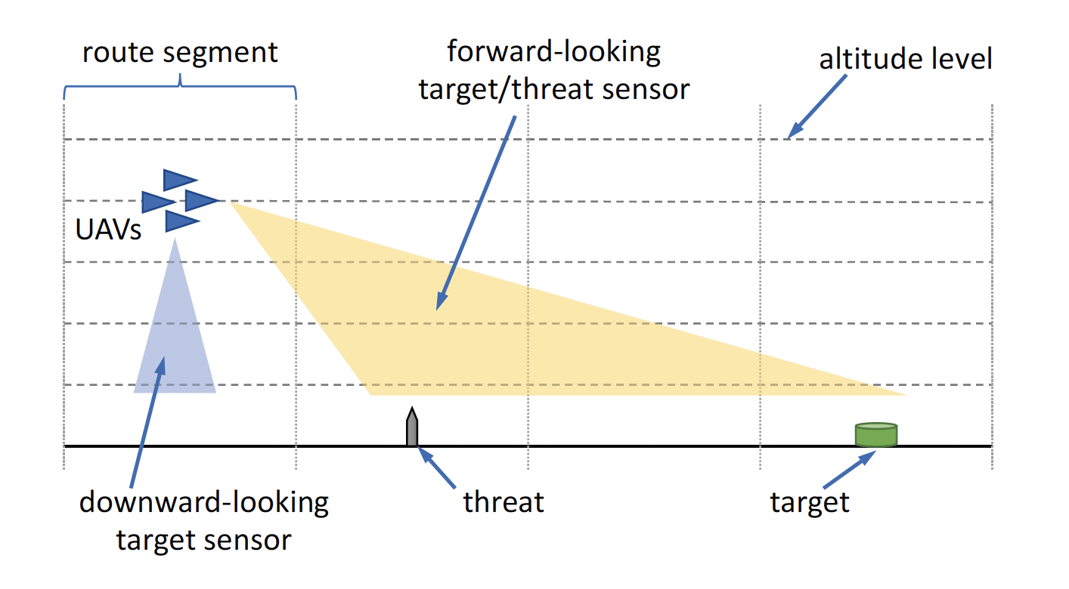
General Applicability
Team of UAVs performing a reconnaissance mission in a hostile environment:
Detect targets on the ground
Avoid being shot down by threats
Outpatient clinic scheduling:
Patient-related concerns: lead times
Physician/system-related concerns: revenue, overtime and idle time
Notes:
Our explainable planning approach is designed to be a general framework that is applicable to many problem domains that concerns multi-objective optimization.
Other problem domains that we have applied our approach to include:
Drones application
Clinic scheduling problem

Slide 9
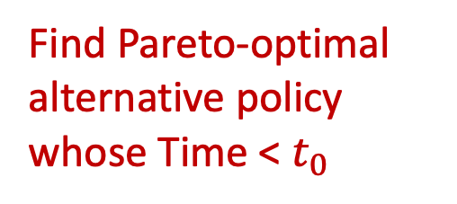
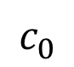
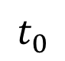
Consequences & Tradeoffs
(deterministic)
Find tradeoff: If & how travel time is compromised for better safety
E[Collision]
Pareto-optimal policies
Dominated policies
Solution Policy
Find Pareto-optimal alternative policy whose Time < $t_{0}$
$$c_{0}$$
Time
$$t_{0}$$
Notes:
To generate alternatives for contrastive explanations, our approach finds Pareto-optimal alternatives neighboring the solution, to quantitatively explain its tradeoffs among competing objectives.
Here we demonstrate the approach using 2 objectives: travel time and safety
Suppose the planning solution is shown in green.
[C] Our approach explains how the solution compromises travel time for better safety, by finding a nearby Pareto-optimal alternative policy that has an improvement in time.

Slide 10
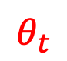
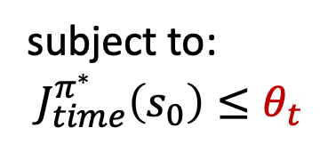

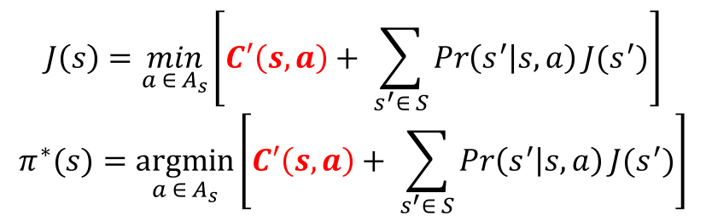

Find Alternatives: Constrained Planning
Demote “Time” objective
$$J\left(s\right)=\min_{a ∈ A_{s}}\left[C′\left(s,a\right)+ \sum_{s^{′}∈ S}{\operatorname{Pr}\left(s^{′} | s,a\right)J(s^{′})}\right]$$
$$π^{∗}(s)=\underset{a ∈ A_{s}}{argmin}\left[C′\left(s,a\right)+ \sum_{s^{′}∈ S}{\operatorname{Pr}\left(s^{′} | s,a\right)J(s^{′})}\right]$$
E[Collision]
subject to: $J_{time}^{π^{∗}}\left(s_{0}\right)≤θ_{t}$
Alternative policy
$$c′$$
Solution Policy
Solve with MILP formulation that ensures deterministic solution
$$c_{0}$$
Time
$$t′$$
$$t_{0}$$
$$θ_{t}$$
Notes:
To find such alternative solution, we solve a constrained optimization problem [C][C], where we put an upper-bound constraint on the time objective to have some small improvement from the current solution, and minimize the rest of the objectives.
[C] The resulting alternative policy is shown in red.

Slide 11
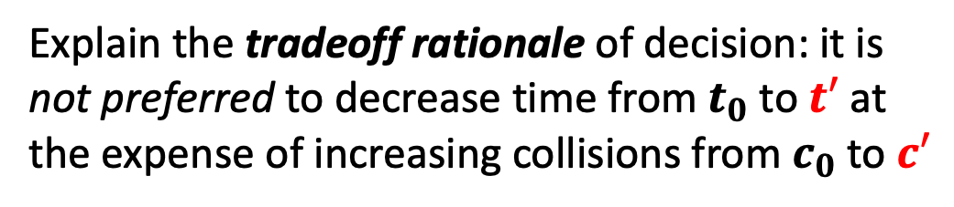
Contrastive Explanation
Explain the tradeoff rationale of decision: it is not preferred to decrease time from $t_{0}$ to $t′$ at the expense of increasing collisions from $c_{0}$ to $c′$
E[Collision]
How travel time is compromised for better safety
Alternative policy
$$c′$$
Solution Policy
$$c_{0}$$
Time
$$t′$$
$$t_{0}$$
Notes:
This alternative will then be contrasted with the original solution to explain the tradeoff rationale; for instance, of how much travel time is compromised for how much better safety.
In general, our approach generates multiple alternatives to explain multiple tradeoff pairs in a planning problem.

Slide 12
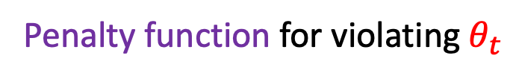


Find Alternatives: Soft Constraints
Alternatives that have too similar values don’t show tradeoffs well
Penalty function for violating $θ_{t}$
E[Collision]
Alternative policy
$$c′$$
Any separable convex penalty function, handled using piecewise linear approximation in MILP
Solution Policy
$$c_{0}$$
Time
$$t′$$
$$t_{0}$$
$$θ_{t}$$
Notes:
With this approach, we need to be careful that we don’t get alternatives that have too similar values to the solution’s, because those don’t illustrate tradeoffs well to human
We can set threshold of 1 obj. to be sufficiently distant from solution’s value. This is domain-specific (just-noticeable-difference, user query), but exact threshold isn’t necessary
In this example, using exact threshold wouldn’t find any alternative solution
Our approach treats it as soft constraint instead, where we use (non-linear) penalty function for violating threshold -> can get alternative that is close to threshold if exists

Slide 13
User Study Evaluation
Task-oriented human subjects study evaluation of explainable planning
Notes:
To evaluate the effectiveness of our approach, we conduct a user study evaluation.

Slide 14
User Study Scenario
Proxy for measuring understanding:
Sparse Obstacles
C_{R}
C_{U}
Semi-
Private
User’s preference for:
Travel time
Safety
Intrusiveness
Start
Private Offices
Goal
Rooms
Dense Obstacles
C_{R} may or may not be C_{U}
“Is the robot’s plan the best option for me?”
Notes:
We create the following user-study scenario using the robot navigation domain presented earlier.
[C] Assuming the user has a fixed preference for the different objectives.
[C] The robot also has a fixed preference captured in its cost function, hidden from the user, [C] which may or may not be the same as that of the user.
[C] The robot generates an optimal navigation plan based on its cost function, and presents the plan to the user.
[C] The user then has to determine whether the robot’s plan is the best available option, according to their own preference.
The user’s ability to correctly assess the robot’s decisions serves as a proxy for measuring the user’s understanding of the robot’s planning rationale.

Slide 15


Control Group
Scenario
Cost Profile
I’m planning to follow path.
It is expected to take 5 minutes, have 0.2 expected collision, and be somewhat intrusive.
Obj. 1: $$
Obj. 2: $
Obj. 3: $$$
Hidden from Participant
Robot’s Navigation Plan
Is agent’s plan the best option? [Yes/No]
Cost Profile
Obj. 1: $
Obj. 2: $$$
Obj. 3: $$
Control
Group
How confident are you? [5-point Likert scale]
Participant
Notes:
We conducted a between-subject experiment to determine the impact of our explanation approach on the user’s understanding.
Each participant is given a cost profile to use as their preference for the different objectives.
[C] In the control group, the only information the participant receives about the plan is its expected objective values, such as travel time and expected collisions.
[C] Then the participant is asked to determine whether the robot’s plan is the best option, according to their given preference, [C] and to rate the confidence level in their answer.

Slide 16
Treatment Group
Scenario
Cost Profile
I’m planning to follow path.
It is expected to take 5 minutes, have 0.2 expected collision, and be somewhat intrusive.
Obj. 1: $$
Obj. 2: $
Obj. 3: $$$
I could reduce the travel time to 4 minutes by following path instead. However, this would increase the expected collision to 0.4 and be very intrusive. I decided not to do that because the reduced time is not worth the increased expected collision and intrusiveness.
Hidden from Participant
Robot’s Navigation Plan
Is agent’s plan the best option? [Yes/No]
Cost Profile
Obj. 1: $
Obj. 2: $$$
Obj. 3: $$
Treatment
Group
How confident are you? [5-point Likert scale]
Participant
Notes:
In the treatment group, [C] the participant additionally receives the contrastive explanations of the robot’s plan.

Slide 17
Scenario Types
Scenario i
Scenario j
Scenario i
Scenario j
Scenario i
Scenario j
Map i
Map j
Robot’s Plan
Robot’s Plan
Preference-aligned
Scenarios
Preference-misaligned
Scenarios
Agent’s plan is the best option for user
Agent’s plan is NOT the best option for user
Notes:
In both control and treatment groups, half of the navigation planning scenarios we present to the users are ”preference-aligned” scenarios, where the robot’s optimal plan is also optimal wrt the participant’s preference. The other half are “preference-misaligned” scenarios, where the robot’s optimal plan is not optimal for the participant’s preference.

Slide 18
Hypotheses
H1: Participants who receive the explanations are more likely to correctly determine whether the robot’s plan is in line with their preference.
H2: Participants who receive the explanations are more confident in their determination.
Notes:
We have 2 hypotheses:
[C] First, participants who receive the explanations are more like to correctly determine whether the robot’s plan is in line with their preference.
[C] Second, participants who receive the explanations are more confident in their determination.

Slide 19
Results: Correctness
Mixed-Effect Logistic Regression: account for random effects from participants, scenarios
Correctness ~ Explanation, Scenario Type
H1 is supported
is on average 3.8 times more likely to be correct with 95% CI: [2.03, 7.12]
Treatment Group
(Given Explanation)
(49 participants)
Control Group
(50 participants)
Scenario j
is on average 0.36 times less likely to be correct with 95% CI: [0.19, 0.70]
Scenario i
Scenario j
Scenario j
Scenario j
Scenario j
Map j
Map i
Agent’s Plan j
Agent’s Plan i
Preference-misaligned
(24 scenarios)
Preference-aligned
(24 scenarios)
Notes:
For the correctness, our results show that, [C] participants who are given explanations are on average 3.8 times more likely to be correct than those in the control group.
[C] And that the preference-misaligned scenario type makes the participants on average 0.36 times less likely to be correct. The negative effect of preference misalignment is smaller compared to the positive effect of explanations.
[C] Thus, our hypothesis 1 is supported.

Slide 20
Results: Confidence
Mixed-Effect Linear Regression: account for random effects from participants, scenarios
Confidence ~ Explanation, Scenario Type
H2 is supported
is on average 0.42 more confident (Medium effect size: d=0.43) with 95% CI: [0.09,0.74]
Treatment Group
(Given Explanation)
(49 participants)
Control Group
(50 participants)
Scenario j
Scenario i
Scenario j
Scenario j
Scenario j
Scenario j
Map j
No statistically significant difference
Map i
Agent’s Plan j
Agent’s Plan i
Preference-misaligned
(24 scenarios)
Preference-aligned
(24 scenarios)
Notes:
For confidence, our results show that, [C] participants who are given explanations on average report 0.42 higher on the confidence rating than those in the control group, which is a medium effect size.
[C] And that the scenario type has no statistically significant effect on the participants’ confidence.
[C] Thus, our hypothesis 2 is supported.

Slide 21
Potential Overtrust When Unexplained
Participants have the tendency to agree with the robot’s decisions, in absence of explanations.
Bad news when the robot is misaligned with the user’s preference.
Control Group

Slide 22
Recommendation
Explanations are especially important when there is preference misalignment
Due to unsolved challenges in attaining agent alignment, value misalignment is inevitable in real-world applications
We recommend that some form of quality-attribute-based contrastive explanation be used in real-world explainable agency

Slide 23
Interactive Explainable Planning
Interactive and iterative mechanisms for explainable planning

Slide 24
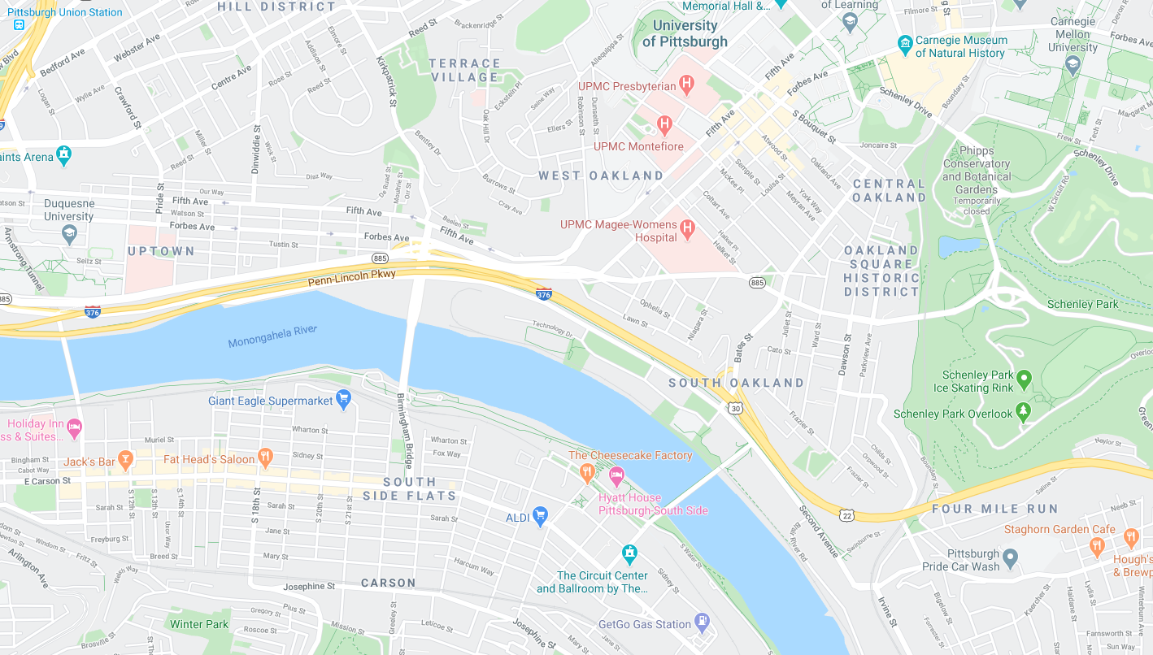
Address Unexpected Behavior
A
Why not ?
B
Notes:
------------------------
User may have questions that are not addressed by the automatically generated (rational) alternatives. This may be caused by mismatch in models, heuristics b/w user & agent, etc. We use mechanism to allow user to ask questions about the agent’s specific behavior: what they expect the agent to do instead. Provide user-guided explanations.

Slide 25
User Query as Planning Constraint
+
Constraint
MDP
Different types of constraints
Different approaches to handle constraints
Re-Planning
User-Guided Explanation
Alternative Solution
Notes:
------------------------
We formulate user query as a constraint in planning. Generate a constraint-satisfying solution to explain consequences of doing what the user expected.

Slide 26


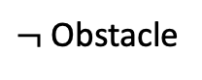
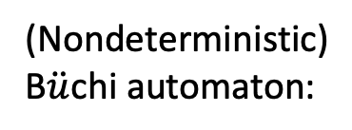
User Query as LTL Property
Linear Temporal Logic (LTL) formulas:
Example: Robot should wait until somebody move the obstacle out of its way.
$φ∷=true \left| a \right| φ_{1} ∧ φ_{2}\left| ¬φ \right| Χ φ | φ_{1} U φ_{2}$
LTL specification:
Wait U ($¬$Obstacle)
Wait
$$⊥$$
(Nondeterministic) B$\ddot{u}$chi automaton:
$¬$Obstacle

Slide 27
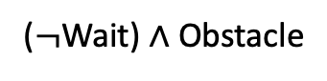

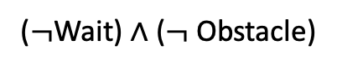

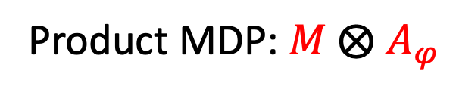

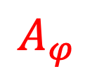


Planning with LTL Constraint
Deterministic Rabin Automaton (DRA):
$$A_{φ}$$
Wait $∧$ Obstacle
($¬$Wait) $∧$ ($¬$Obstacle)
$$⊥$$
q₂
q₀
q₁
$$⊥$$
($¬$Wait) $∧$ Obstacle
Wait $∧$ ($¬$Obstacle)
$$M$$
Product MDP: $M$ $⨂$ $A_{φ}$
Explain consequences of query & tradeoffs
Planning: reaching acceptance condition
MDP
Constraint-Satisfying Policy

Slide 28
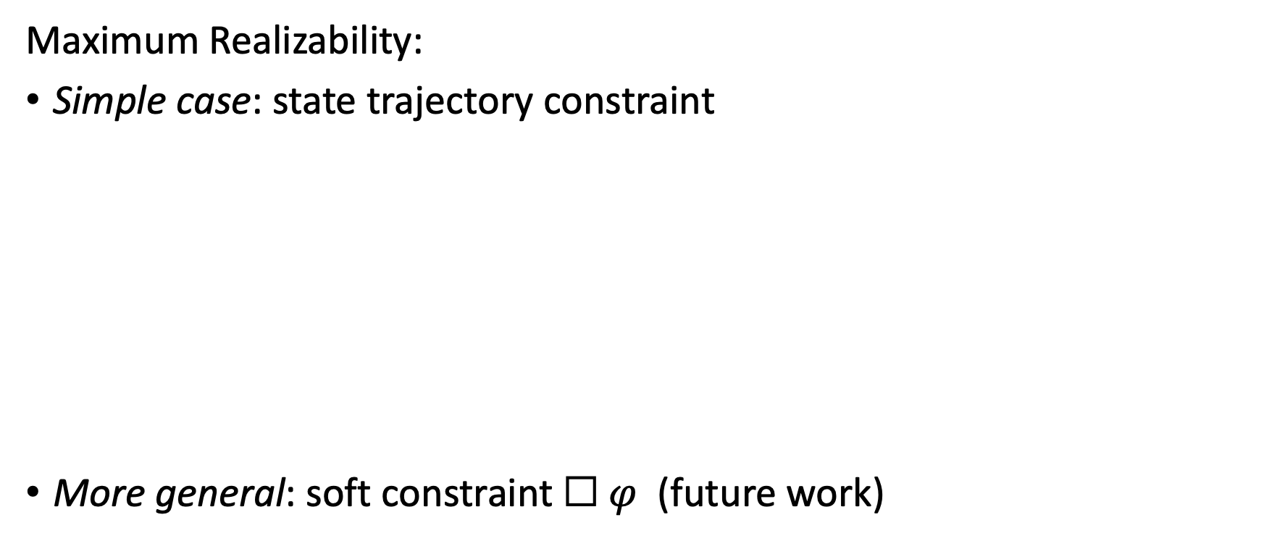
Handle Unsatisfiable Query
Maximum Realizability:
Simple case: state trajectory constraint
More general: soft constraint $☐ φ$ (future work)
…
s₁
s₂
s_{k}
State Trajectory Constraint
Maximum Realization

Slide 29
Iterative Query & Explanation
Query 1
M₁
M₀ + constraint₁
User can iteratively refine their queries to clarify their questions, to get refined explanations.
Explanations
M₀
Query 3
M₃
M₂ + constraint₃
Explanations
Query 2
M₂
M₀ + constraint₂
Query 5
Explanations
…
Query 4
M₄
M₂ + constraint₄
Explanations
Query 6

Slide 30
Evaluation of User-Guided Explanation
Scenario 1
Map 1
Why not
Agent’s Plan 1
?
Is agent’s plan the best option? [Yes/No]
Cost Profile
Obj. 1: $
Obj. 2: $$$
Obj. 3: $$
How confident are you? [5-point Likert scale]
Participant
Notes:
On-going work
Empirical evaluation of our user-guided explanation approach

Slide 31
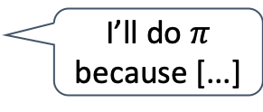
Summary
Goal
Approaches
Explainable Planning:
Tradeoff-focused contrastive explanation
Interactive explanation
I’ll do $π$ because [...]
Transparency and intelligibility of multi-objective planning
Results
Explanations improve understanding, confidence in assessing agent’s decisions
General framework
Notes:
To conclude, we propose an explainable multi-objective planning approach that provides justification for why the agent chooses a particular solution.
Our approach provides consequence-oriented contrastive explanations to convey the tradeoff rationale of planning,
And also provides mechanism for the user to ask questions about why the agent chooses specific behaviors in its solution.
Our approach is shown to improve users’ understanding of the agent’s reasoning, and confidence in assessing planning decisions.

Slide 32
Backup Slides

Slide 33

Planning Representation
Reward decomposition; preserve domain-level semantics
Explicit, compact representation of quality-attribute analytic models
Quality-attribute analytic model is a function of state variables, actions and their attributes
Allow rich queries from user [discussed later]
state_var : Type, attributes = {attr_1: Type, …}
action: Type, attributes = {attr_1: Type, …}
$${QA}_{i}:S × A → ℝ$$
Notes:
I’ll first talk about the explainable representation
Our approach relies on reward decomposition, which is breaking down the total rewards of agent into sub-rewards, each corresponds to a meaningful concern of the task.
Our explainable planning representation preserves the domain-level semantics of these sub-rewards, in the form of its computation model
We augment a factored representation of MDP: state vars and actions have types and associated attributes
This enables us to explicitly represent the QA analytic models in a planning problem in a compact way. QA analytic model is a function of state vars, actions, their attributes.

